Slide 1
Impact of Rural Broadband Development Programs
Data Science for the Public Good Intern
Steve Zhou
Annie Xie
Social and Decision Analytics Division, University of Virginia
Josh Goldstein
Neil Kattampalil
Leonel Siwe
Sponsored by:
John Pender, Economic Research Service - U.S. Department of Agriculture

Slide 2
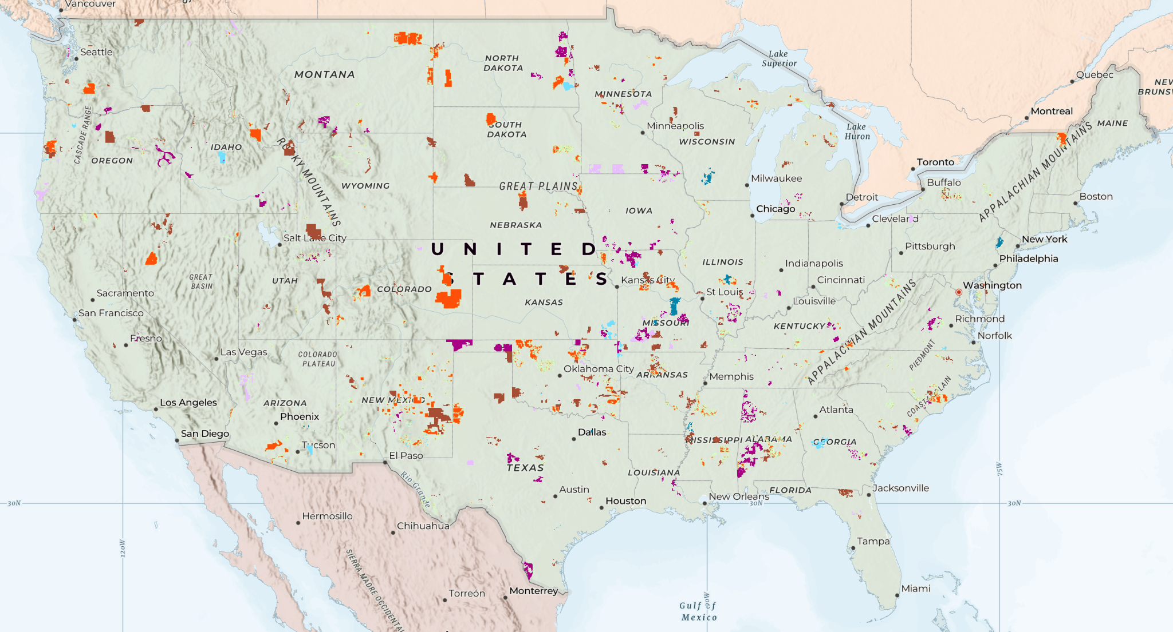
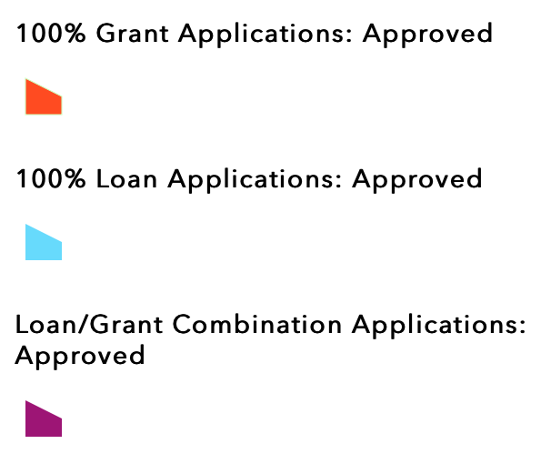
Introduction to ReConnect
ReConnect aims to offer broadband access in rural areas by providing grant and/or loan for eligible applicants
316 projects approved and $3.86 billion invested over 2019-2023
Data Source: U.S. Department of Agriculture
Figure 1: Distribution of Approved ReConnect Projects

Slide 3
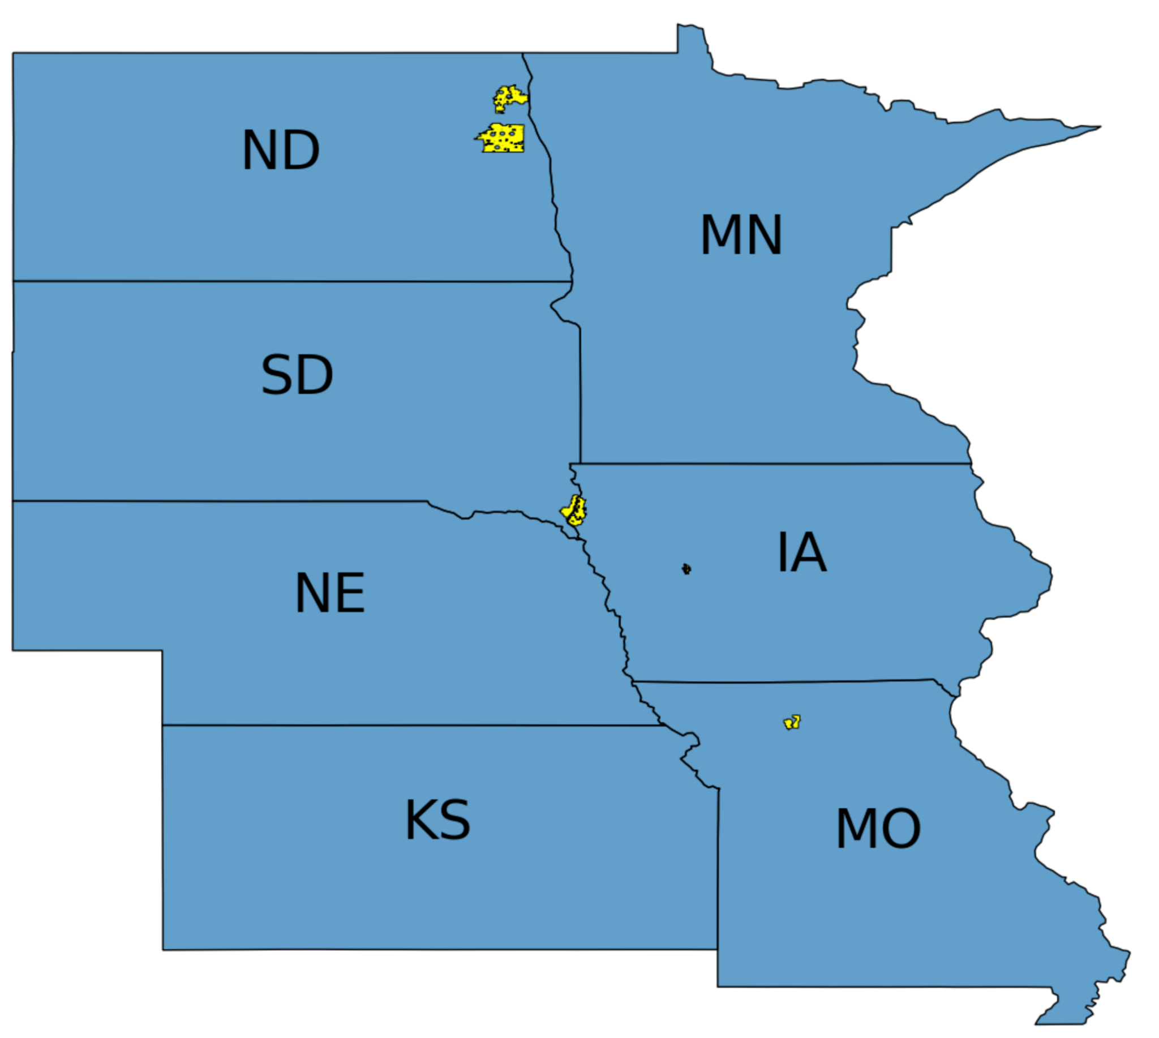
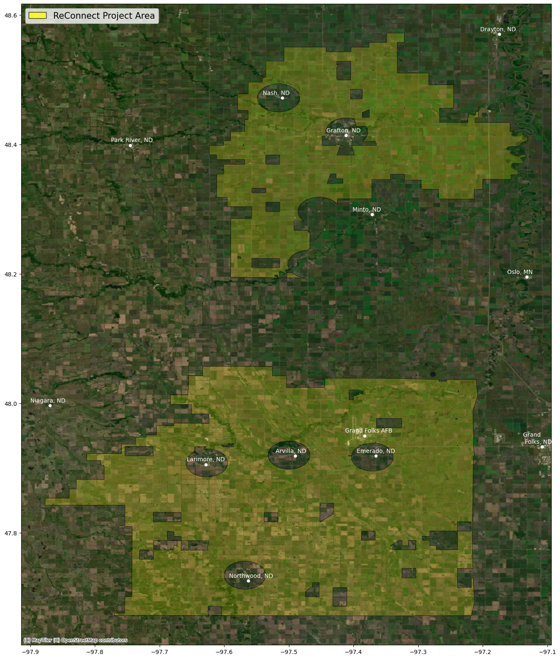
Goal: Assess the Impact of ReConnect
Examine improvement in internet speeds in ReConnect project areas
Focus on three finished projects in the Midwest
Example: project ND1702-A59 in Walsh County and Grand Forks County, North Dakota
Figure 2: Sample ReConnect Project in North Dakota
Notes:
Actual improvement.
Again, new program, under construction, where the residents .
Here's a sample.

Slide 4
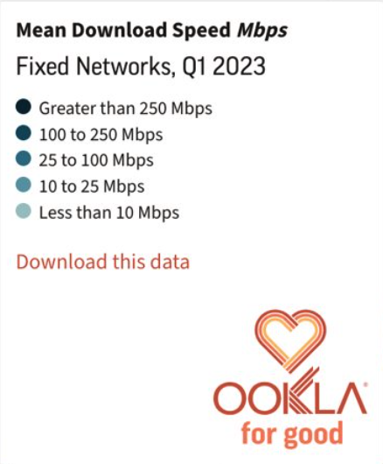
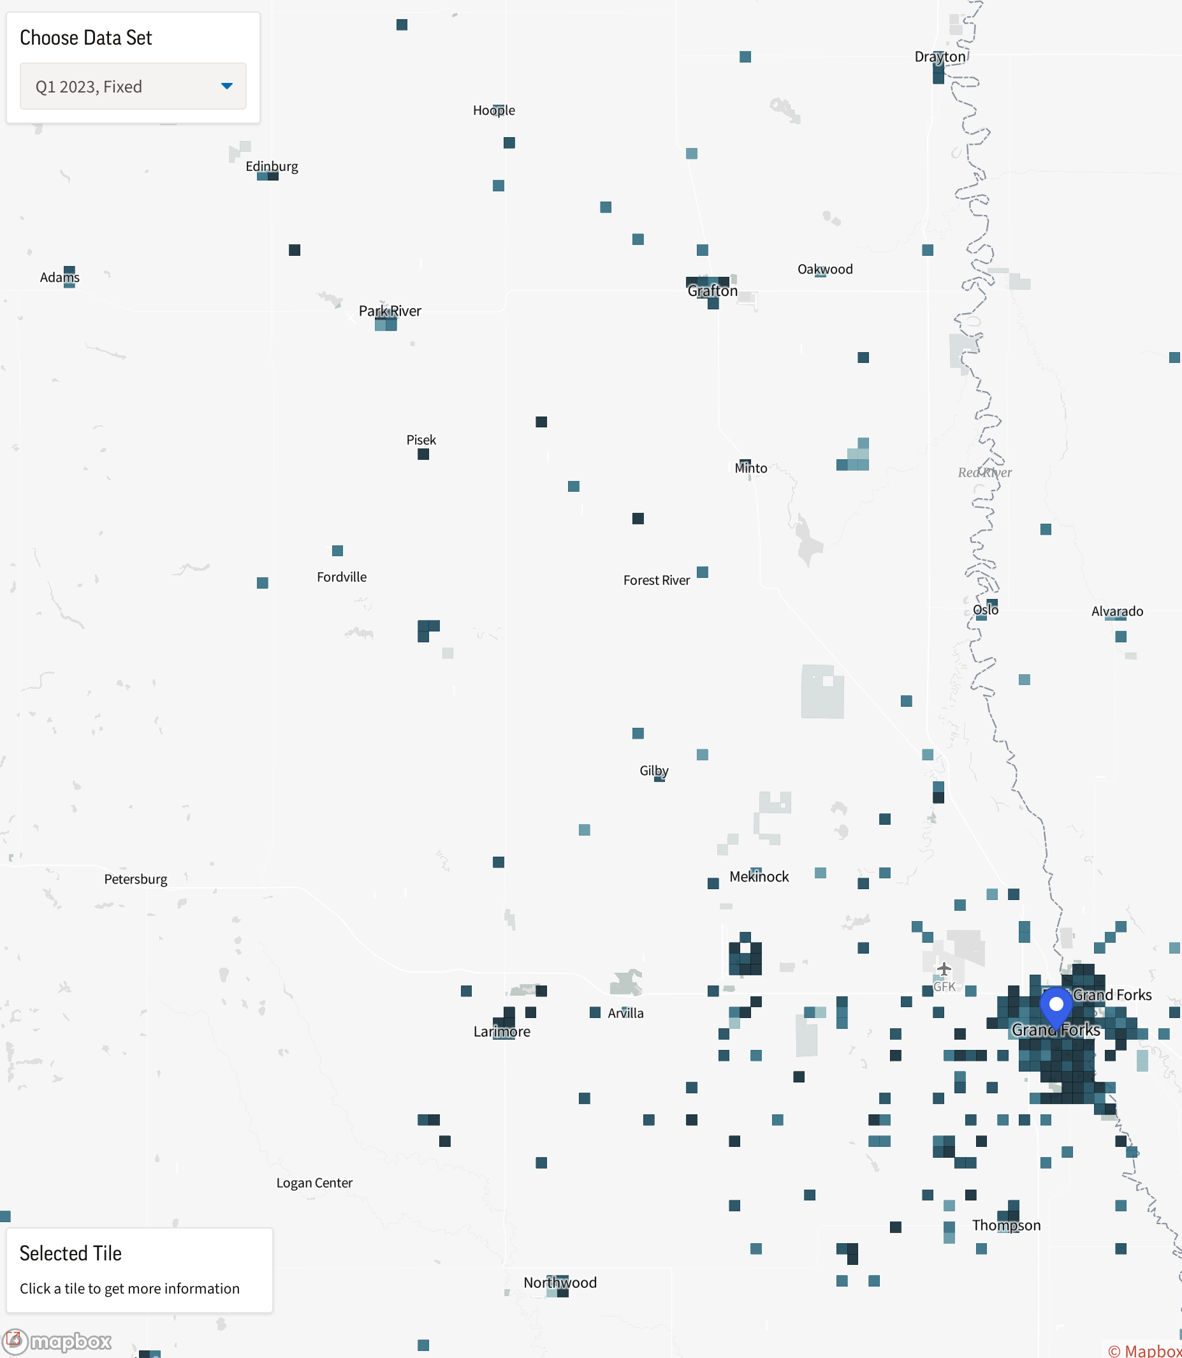
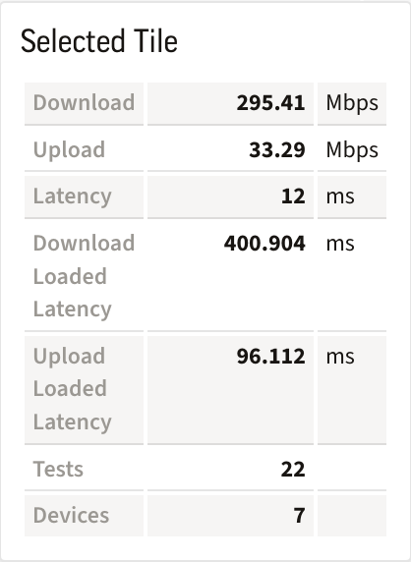
Goal: Assess the Impact of ReConnect
Examine improvement in internet speeds in ReConnect project areas
Focus on three finished projects in the Midwest
Example: project ND1702-A59 in North Dakota
Use Ookla Data to access the internet speeds
Data Source: Ookla Open Data
Figure 3: Mean Download Speed in the Sample Project Area
Notes:
To access the internet speeds inside and outside, and before and after the construction, we will use ookla data.
Ookla provides worldwide speedtest. When you use ookla to test internet speeds on your device, the results will be recorded and then averaged and reported in these small tiles. Next Steve will introduce the other datasets we are going to use and our approach

Slide 5
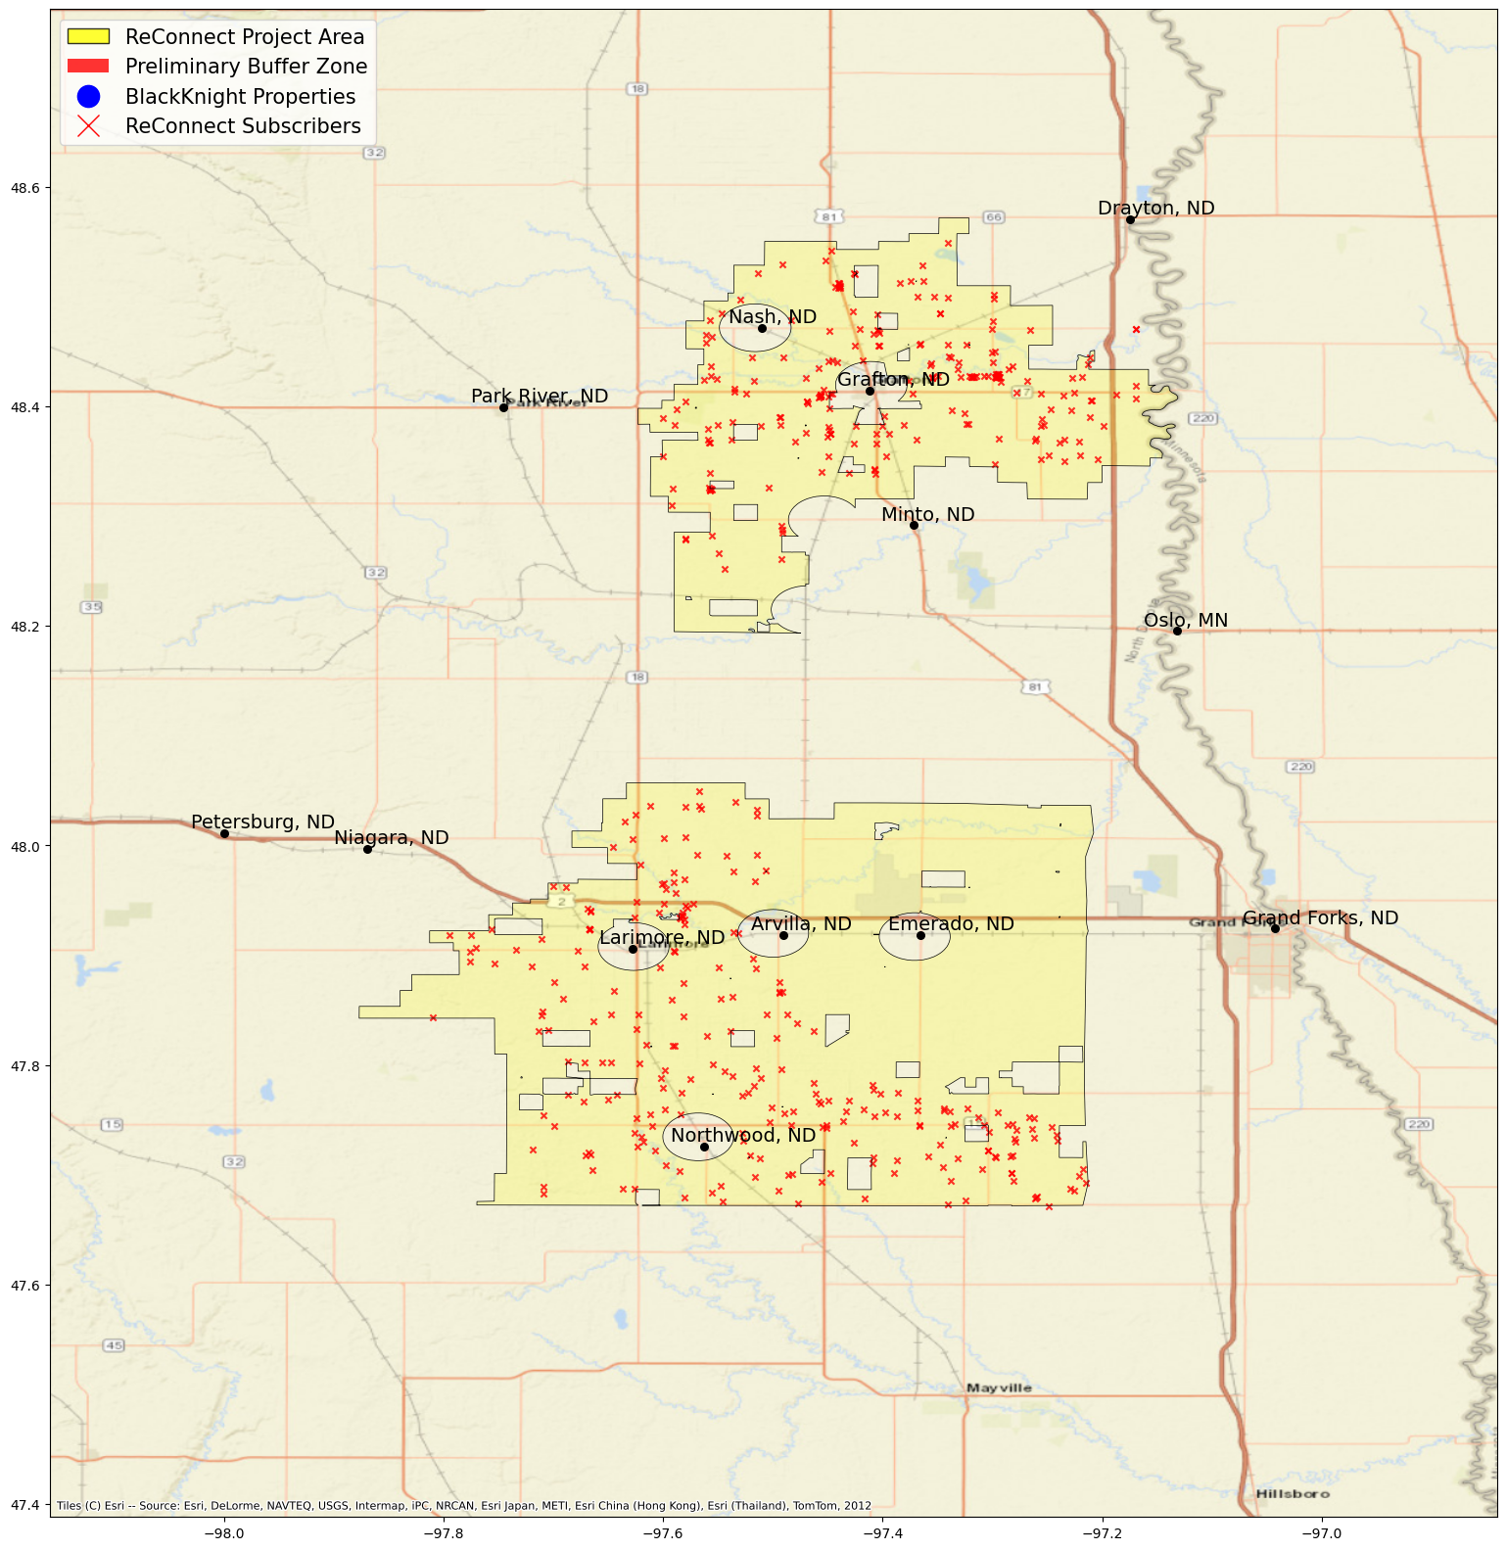
Data Overview
Ookla Data
Subscriber data
Location, address, speed plan, etc.
Notes:
We want to see if there is improvement in internet speed for the subscribers in these project areas. For now, we are focusing on three project areas that have implemented broadband construction.
Subscriber data

Slide 6
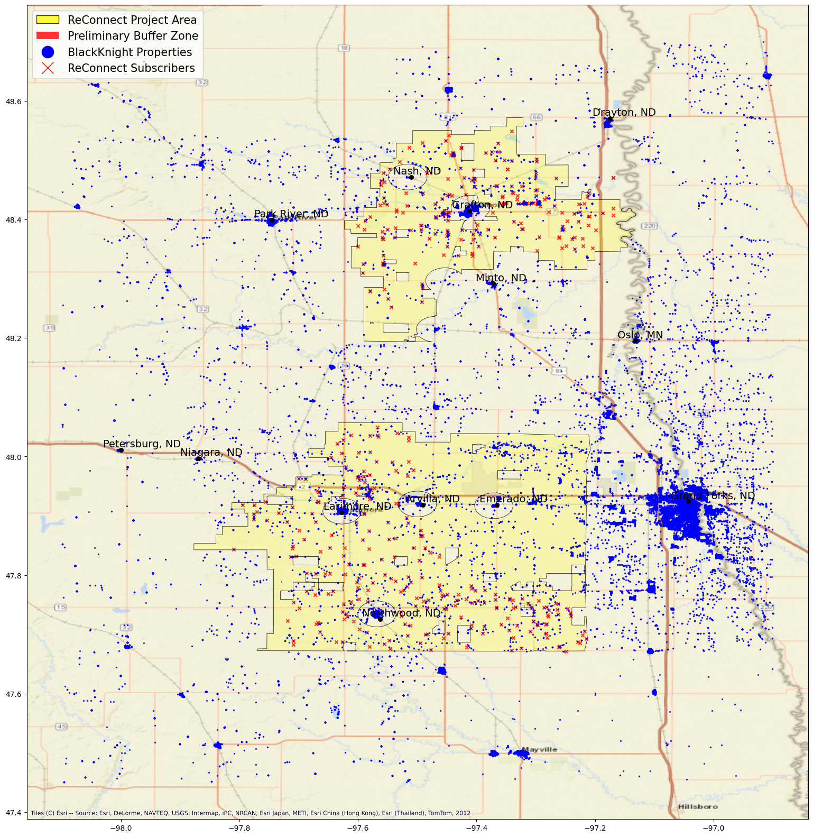
Data Overview
Ookla Data
Subscriber data
Location, address, speed plan, etc.
BlackKnight real estate data
Location, address, #bedrooms, etc.
Notes:
We want to see if there is improvement in internet speed for the subscribers in these project areas. For now, we are focusing on three project areas that have implemented broadband construction.
Subscriber data

Slide 7
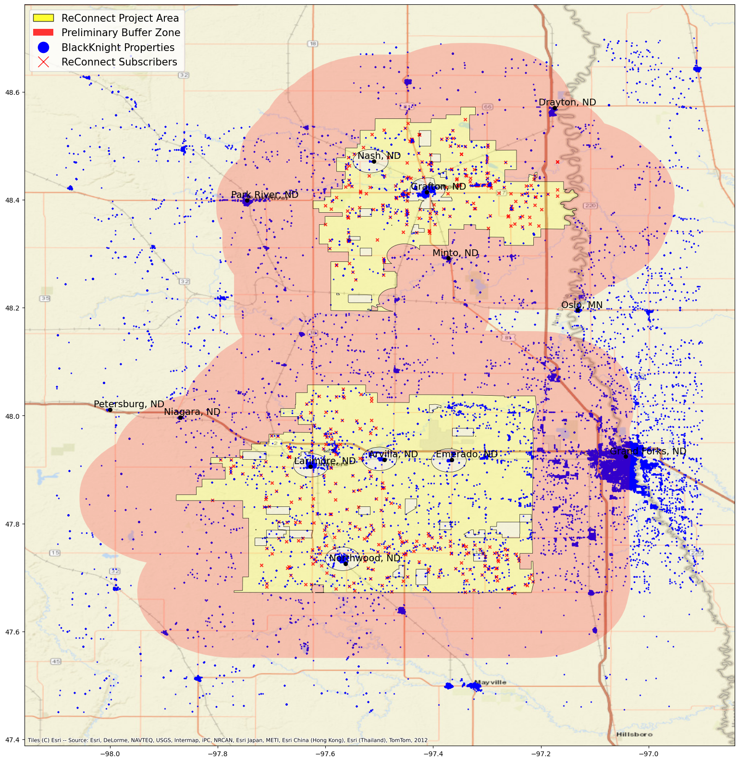
Data Overview
Ookla Data
Subscriber data
Location, address, speed plan, etc.
BlackKnight real estate data
Location, address, #bedrooms, etc.
Buffer zone
Notes:
We want to see if there is improvement in internet speed for the subscribers in these project areas. For now, we are focusing on three project areas that have implemented broadband construction.
Subscriber data

Slide 8
Strategy: Difference-in-difference
Treatment group
Subscriber data
Control group
BlackKnight data
Filtered rural blocks in buffer zone
Rural Urban Commuting Area (RUCA) code by USDA ERS
Notes:
We want to see if there is improvement in internet speed for the subscribers in these project areas. For now, we are focusing on three project areas that have implemented broadband construction.
Subscriber data

Slide 9
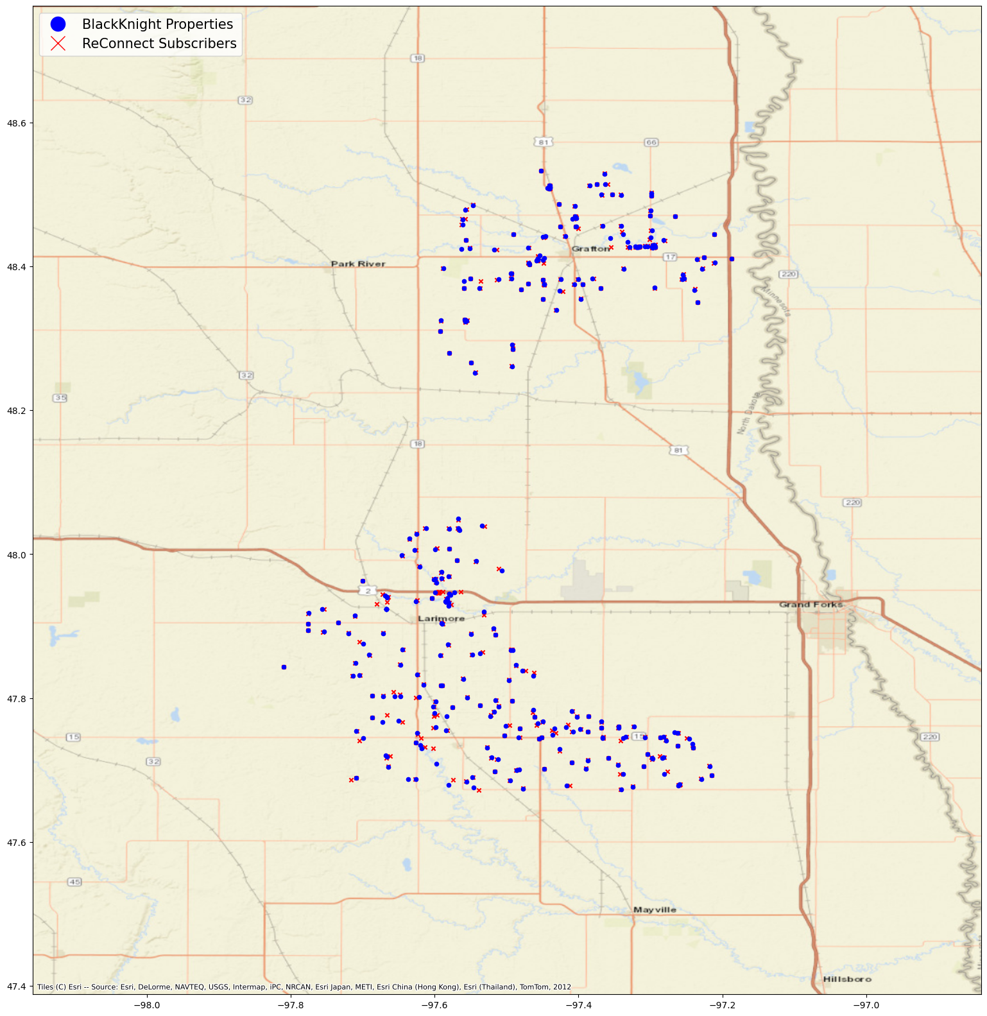
Matching Subscriber Data
To gain insights for ReConnect subscribers from BlackKnight property data
Street address exact matching
Highest Reliability
Only covers 32.1% of subscribers
Nearest property matching
Potentially a universal method
Quality of BlackKnight geocoding?
Avg. 86 meters away, even in address-matched assets

Slide 10
Table 1: Comparing Geocoding APIs
Cleaning BlackKnight Data
API | Bing | Census | OpenStreetMap
Limit | 50,000/day | 10,000/batch | 1/second
Test Results of Two Samples (N = 500 each)
Match rate | 98% | 85% | 73%
Speed | 0.2-0.25s/query | 0.01-0.02s/query | 1s/query
Avg. Difference in Distance | 26m | 94m | 229m
Raw Dataset:
516,273 records
Detailed information on properties
Cover residential, commercial and other land use
44.8% missing addresses
Subset:
358,494 records
27.3% missing addresses
Subset with complete addresses:
250,359 records
246,122 records
Need Verifying
Remove vacant lands based on standardized land use code
Fill in the blanks based on given information (e.g. house number, city, state, etc.)
Try accessor parcel number to address
3608 records with the same coordinates but different addresses 629 records with the same addresses but different coordinates
Separated by county
Subset with missing or incomplete addresses:
108,135 records
Need Geocoding
Notes:
On a national level
Focus on the states where our project areas are
Tried to clean the dataset and fill in the blanks so we can
But we still have 108 thousand records with missing or incomplete addresses
Focus on complete
Took a closer look and separated the problematic records. These geocoding
For the rest , need verifying. How good the coordinates provided by blackknight data are
To do that, we selected three free geocoding apis and compare their performance.
In terms of

Slide 11
Next Steps
Finish the mechanism to clean the entire BlackKnight data
Further clean and match the subscriber data
Overlay the selected samples with Ookla data
Perform difference-in-difference models and assess the impact of ReConnect on internet speeds in selected projects

Slide 12
Q&A
Steve Zhou​
Annie Xie

